Slide 1
Indian Institute of Technology Kharagpur
M. Tech Project Presentation
BANKING FRAUD DETECTION USING GRAPH NEURAL NETWORKS
PRIYANK MUNDRA (20EC39024)
SUPERVISOR: PROF. PABITRA MITRA
CO- SUPERVISOR: ARJIT DE
Notes:
Good morning, everyone, Firstly My name is Priyank Mundra, a final year student in the department of Electronics and Electrical communication Engineering pursuing my master in Vision and Intelligence Systems.
I want thanks my both of the supervisor, Professor Pabitra Mitra and Professor Arijit De for giving me this opportunity to work under them. My topic for my MTP is Bank Fraud detection using Graph Neural Networks

Slide 2

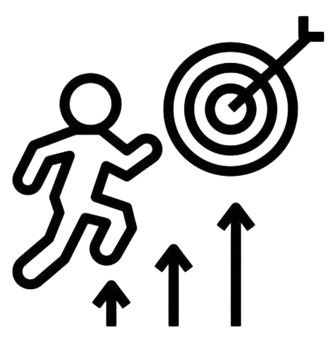
Project Objective and Motivation
Objective
Motivation
Predict whether a node or a series of transactions in a graph is fraud, enabling financial institutions to address fraud proactively and minimize risks.
Leverage Graph Neural Networks to detect intricate fraud patterns by analyzing transaction behavior, focusing on interconnected accounts and multi-step trails.
Fraudulent activities increasingly involve layered transactions across multiple interconnected accounts, making detection difficult for traditional systems.
Existing methods focus on individual transactions, missing broader fraud patterns. This project shifts the focus to analyzing node behavior in transaction graphs to uncover complex fraud schemes.
Notes:
My objective for this project is predict the node or the transaction trails in given transaction graph as Fraud or Not Fraud, basically it is an anomaly detection problem but is a graph, so I will be using Graph neural network. But why we need to do this, there are model which can do the Bank Fraud detection in very effective ways? The reason behind this is existing Techniques only focus on transaction which are from one account to another i.e., This sample only include only two account in it one is sender and one is receiver. Fraudster have found ways which can bypass this type of model very easily, some of these technique include using multiple accounts.
They increase the number of transaction to make it more complex to detect or they move the large amount of the money from one account to another account to not get detect due to large amount of transaction. This is why we made a graph of transaction which will help to include the information of all the connected transactions not just one.

Slide 3
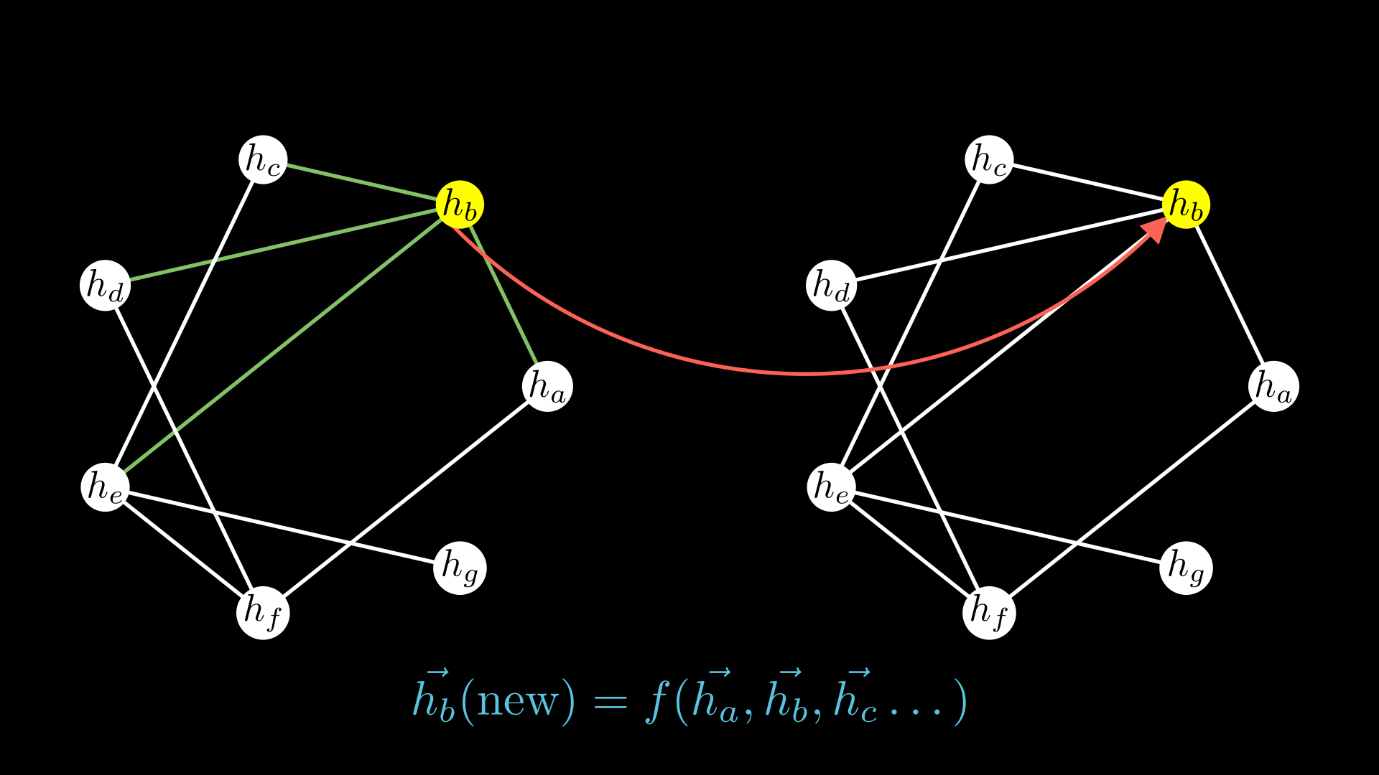
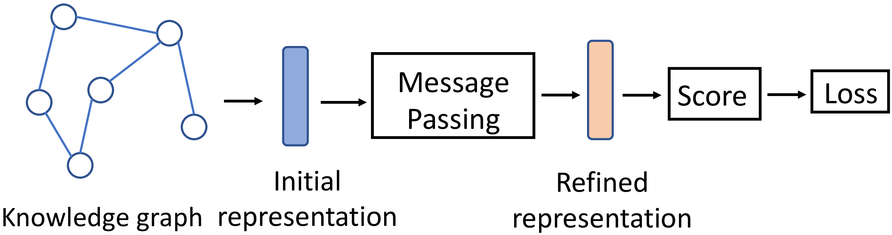
Graph Neural Network
01
Introduction
Definition: GNNs are a type of neural network designed to process and analyze graph-structured data.
Graph Components: Operate on nodes (entities) and edges (relationships) in a graph.
Purpose: Learn node, edge, or graph-level embeddings for various predictive tasks.
Mechanism: Use message-passing to aggregate information from neighbors.
02
Key Characteristics of GNNs
Feature Propagation: GNNs propagate information across the graph
Representation Learning: They generate embeddings for nodes, edges, or entire graphs.
Flexibility: GNNs can handle graphs with varying sizes, sparsity, and irregular connectivity.
Notes:
For now, lets just see what is GNN and How it works in short.
Graph Neural Network is just like a Normal Neural network only difference is that it take input a Graph data structure. Every node in a Graph have Feature vector and if edge has feature then there will be a feature vector too. What GNN do is, It try to represent a node, or edge, or a subgraph or a Graph using a vector, if I try to put it into an analogy with NLP word will be as a node and sentence will be Graph. But how does GNN do this? It uses a mechanism call Message passing, in short, I can say it gather the information from its neighbor and update feature vector. If I am using one layer it will gather information from one hop distance, if I am using 2 layer then it will gather information from 2 hops basically from neighbor of neighbors. This type of learning is also called Representation learning.

Slide 4
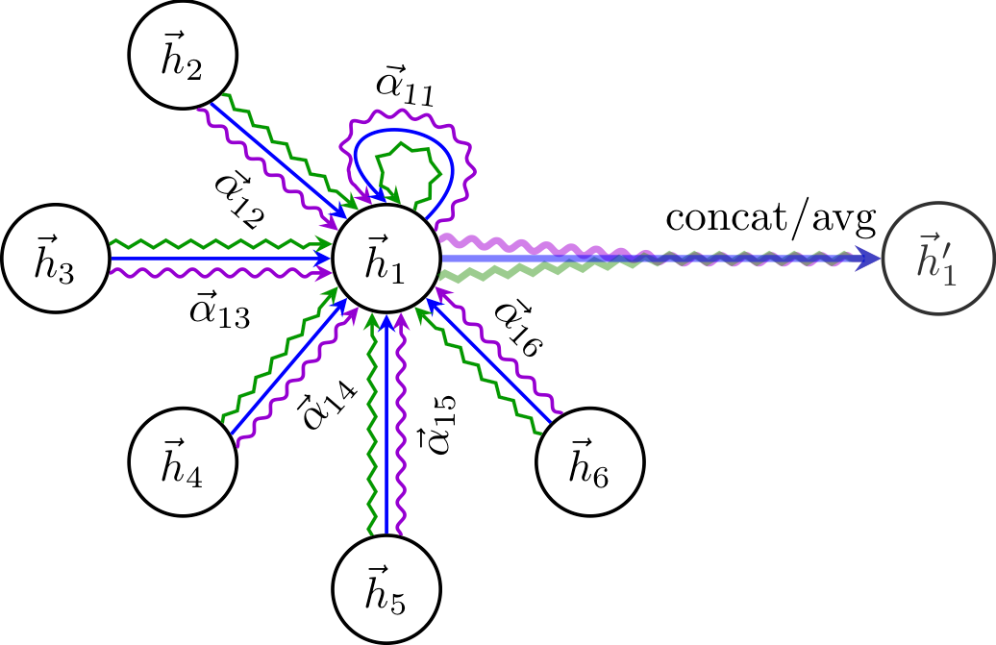
Graph Attention Network (GAT) for Fraud Detection
01
Why GAT?
Focus on Relevant Nodes: GAT assigns different attention weights to neighboring nodes, helping the model focus on the most relevant parts of the graph.
Prioritizing Important Connections: Allows the model to identify critical relationships that might indicate suspicious activity in fraud detection.
02
Learning Important Relationships
Attention Mechanisms: GAT learns which connections (edges) are most significant for each node.
Detecting Patterns: Useful for identifying intricate patterns of influence or repeated transactions.
Fraud Detection Application: Highlights connections that could signify fraudulent behavior between accounts.
Notes:
We are going to use Graph attention Network for our project, but how it is different from normal GNN and why I am using GAT? In normal GNN we give equal weightage to every node no matter what whether information from that node is relevant or not, but in GAT it is different we calculate the attention weights for every node and use those values to pass the information, as we can see in the image, but we there are three different arrows, these are because of number of heads, here according to image the layer have three heads, it is because sometimes one head is not able to converge to we use more than one heads That’s why I decided to move with so that It will give more weightage to important node and allows the model to identify critical relationships that might indicate suspicious activity in fraud detection.

Slide 5
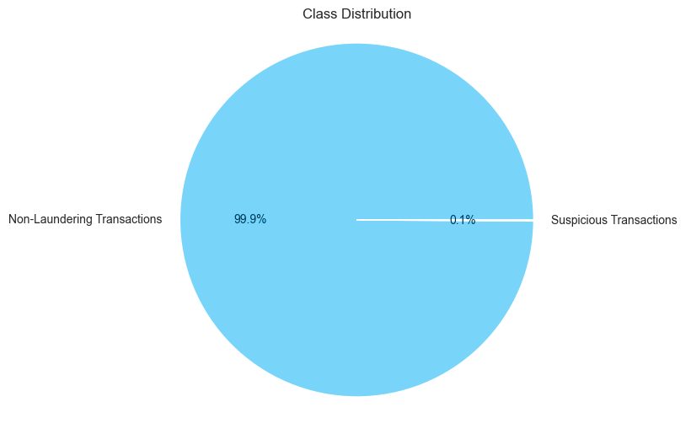
Dataset Overview
01
Dataset Composition
The dataset consists of over 9.5 million banking transactions. This includes 9,873 fraud samples and 9,494,979 non-fraud samples, creating a highly imbalanced dataset.
02
Key Features
Each transaction includes features such as
time,
date,
sender and receiver account numbers,
transaction amount,
currency types(dollars, euros, INR,... etc.) ,
sender and receiver bank locations (UK, USA, Pakistan, India,... etc.),
payment type (credit card, cheque, debit card,... etc.), and
fraud labels (0,1).
These features provide valuable insights for identifying suspicious patterns.
03
Issues and subset creation
Due to limitations in computational power, a subset of this dataset was created with all fraud samples and a representative selection of non-fraud samples.
Reference to Dataset Here
Notes:
Now let's move to the dataset, we didn’t find any existing Graphical data of transactions so we decided to make one, after checking, this dataset from Kaggle is the best dataset which we can use. Because this dataset is able to make graph connect, because there are multiple sample which have same account as sender or a receiver, I checked it and I get there at least 5000+ trails of transaction which have more that 10 accounts. So, we decided to more we this dataset. This Dataset have 9.5 million sample and only 0.1% are Fraud sample, so it make very highly imbalance dataset. Since I check it take almost 14 to 15 hrs to create a complete Graph for this much big dataset so I decided to make the dataset smaller since I don’t have that much computational power.

Slide 6
Dataset Construction
Goal
Objective: Create a small, representative dataset that supports graph-based analysis for fraud detection.
Focus: Ensure that the dataset captures important connections, particularly for accounts involved in fraudulent activities.
Solution: Carefully select non-fraud samples to maintain representativeness and ensure meaningful graph construction
Original Dataset (9,504,852 samples)
Fraud (9,873 samples)
Not Fraud (9,494,979 samples)
Taking all the sample of Frauds (9873 samples)
First Part (Non-Fraud Transactions from Fraud-Associated accounts)
Accounts involved in fraud (either as sender or receiver) are included
Second Part (Non-Fraud Transactions from Clean Accounts)
Non-fraud transactions from accounts with no prior involvement in fraudulent activities.
Taking 40% of size of final dataset i.e., 59238 samples
Taking 60% of size of final dataset i.e., 88857 samples
Final Dataset (9,873 Fraud + 148,095 (15 times) Not Fraud samples)
After making the dataset, number of unique accounts = 138,388
Notes:
Our objective is to create a smaller dataset but we cannot randomly select the sample since it should result in making a connected graph, if the graph is not nicely connected then there is no point of using GNN. So, we decided to select all the Fraud sample and get 15 times more Not Fraud sample but we have to select Not Fraud sample carefully….Now explain the flowchart.

Slide 7
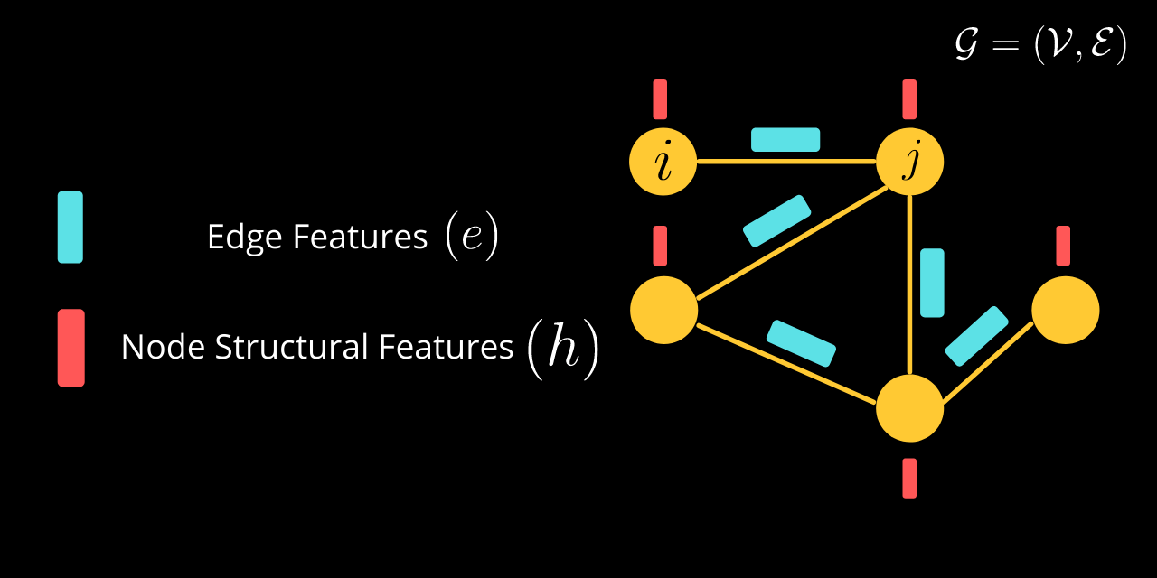
Graph Construction
01
Overview
Objective: Create a graph using the dataset I have created for graph-based analysis for fraud detection.
Node: Represent unique accounts (sender or receiver)
Edges : Represent individual transactions between accounts
02
Features
Node Features:
Location: Most frequent sender/receiver location Currency Type: Most frequent type used
Transaction Frequency: Out-degree (transactions sent) and in-degree (transactions received).
Suspicious Count: Number of suspicious transactions associated with the account.
Edge Features:
Amount: Transaction size (continuous feature).
Payment Type: Identify Transaction method (Credit, Debit, Cheque)
Date: Date encoded as a continuous feature to capture temporal patterns.
03
Graph Properties
Nodes: The graph contains 138,388 unique nodes, each representing an account involved in transactions (either as a sender or receiver).
Edges: The graph includes 158,968 edges, where each edge corresponds to a transaction in the dataset, representing relationships between accounts.
Notes:
We now have a dataset which we can use to make a graph here Node will represent an Account and edge will represent the Transaction between those two account.
Each node has its own feature like: Location, Currency type, Transaction Frequency, and Suspicious count: here Location and currency will be multiple so we decided to take the most Frequent one and as for the Transaction Frequency will be the in-degree (Received money) and out-degree (send money) count and Suspicious count will be the count is the number of times he was the part of Fraud Transaction.

Slide 8
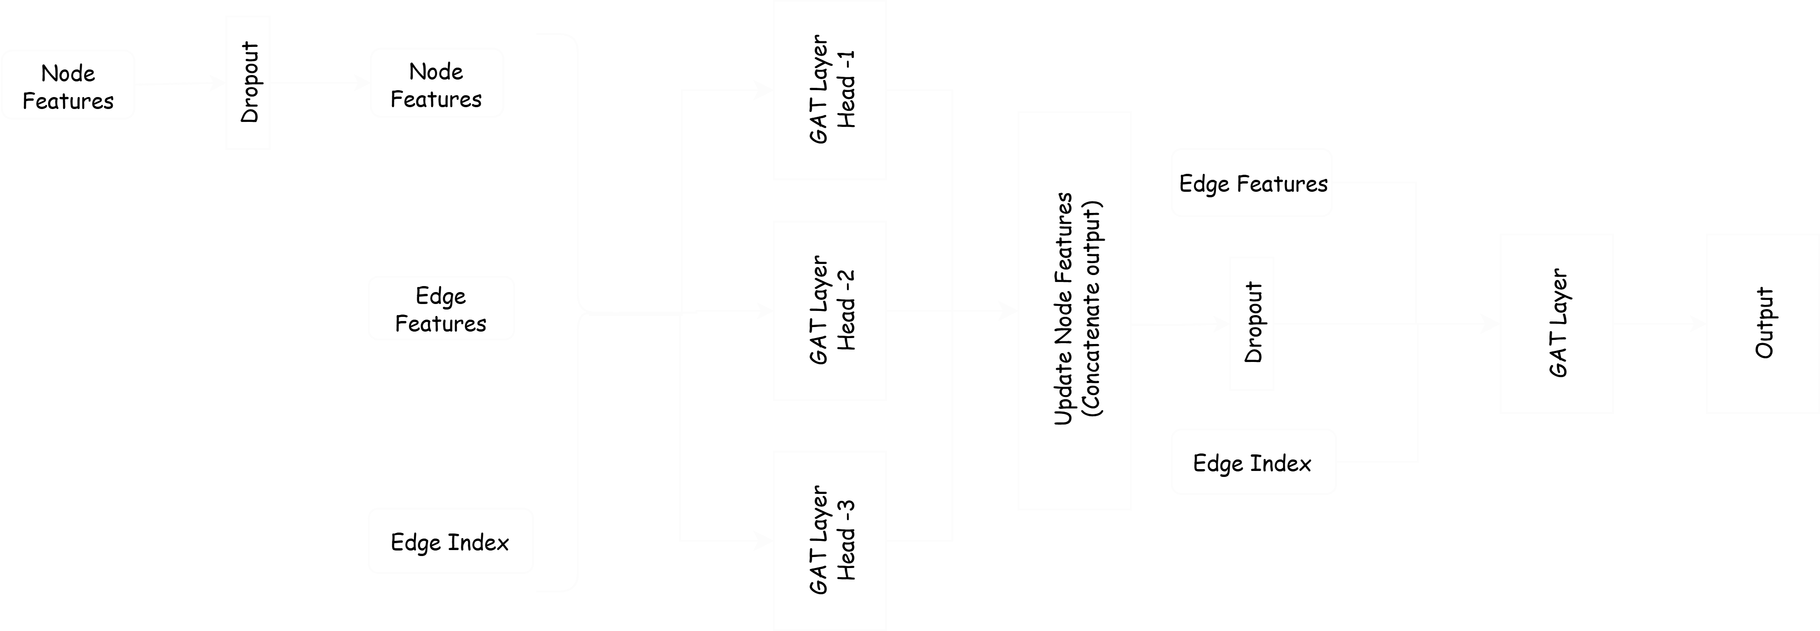
GAT Model Architecture
Notes:
I have used two Graph Attention model and this is one of them I have used three heads for 1st layer of Graph convolution and Number of hidden units are 16. After passing through the first layer there will total three outputs from each head and we will concatenate them and send to the next layer after passing through the Dropout layer for prevention of overfitting and Get the output. For this model 60% of the Fraud were classified as Fraud.

Slide 9
Edge-Enhanced GAT Model
Architecture
Edge-Enhanced GAT combines GAT with edge feature transformation using an MLP. The model processes both node and edge features, improving attention
Data Flow
The model takes node features, edge indices, and edge features as inputs. The edge features are transformed by the MLP, then passed through two GAT layers (multi-head in Layer 1, single-head in Layer 2) with dropout for regularization.
The attention mechanism learns from both node and edge features, while dropout regularization ensures better generalization by preventing overfitting.
Key Features
Notes:
This is the second model - Edge-enhanced model. The Edge-Enhanced GAT model is the better version of GAT model with edge feature Transformation using a multi-layer perceptron, this part will help the GAT model to calculate the attention in better way Here in my model architecture, I have used 1 hidden in MLP and I have two GAT layer with dropout for regularization, this dropout layer is also help to prevent overfitting because in fraud detection we already have very less data of fraud sample and very high amount of sample for Not fraud, so we have to make sure that model doesn’t overfit.

Slide 10
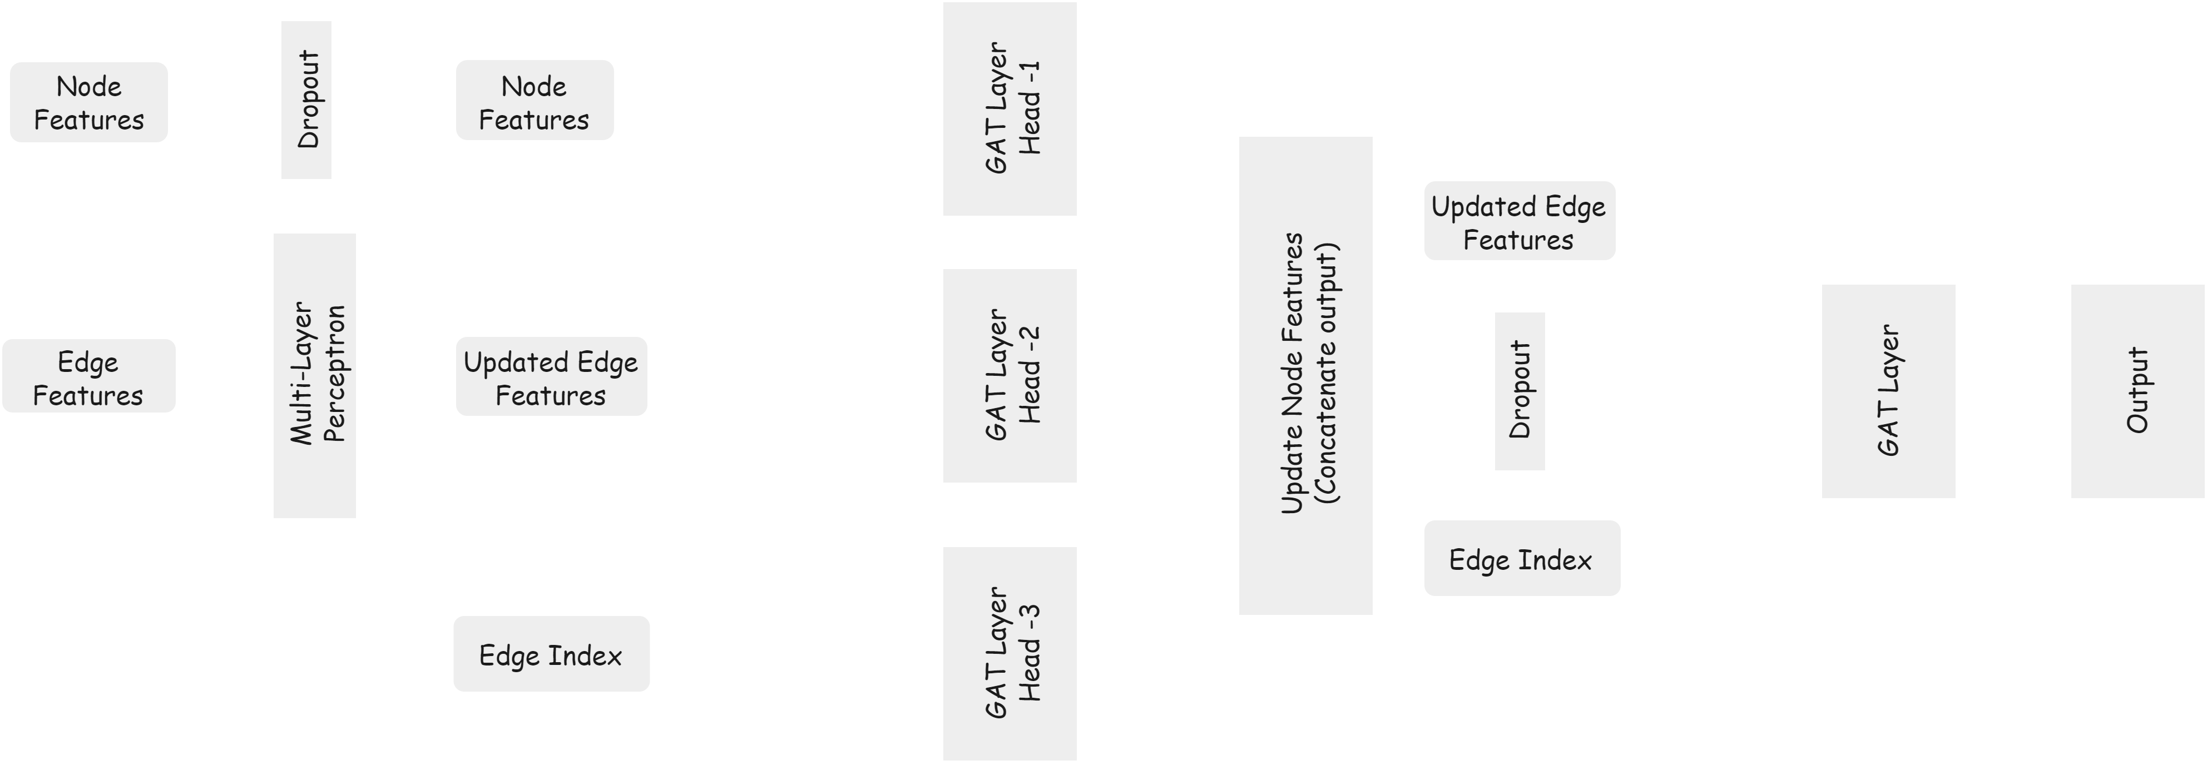
Edge-Enhanced GAT Model Architecture
Notes:
This model is same as the previous model as I have explained in the last slide Edge feature will now first pass through a MLP layer with one hidden layer and Transform the edge feature add pass to the model as I have discussed in GAT model Due to this add on of MLP layer there was as improvement in TPR score it move from 60% to 69%. I have use weighted precision so the Fraud sample will also contribute to the score and there was no change in their precision it was 93%.

Slide 11
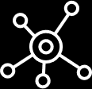
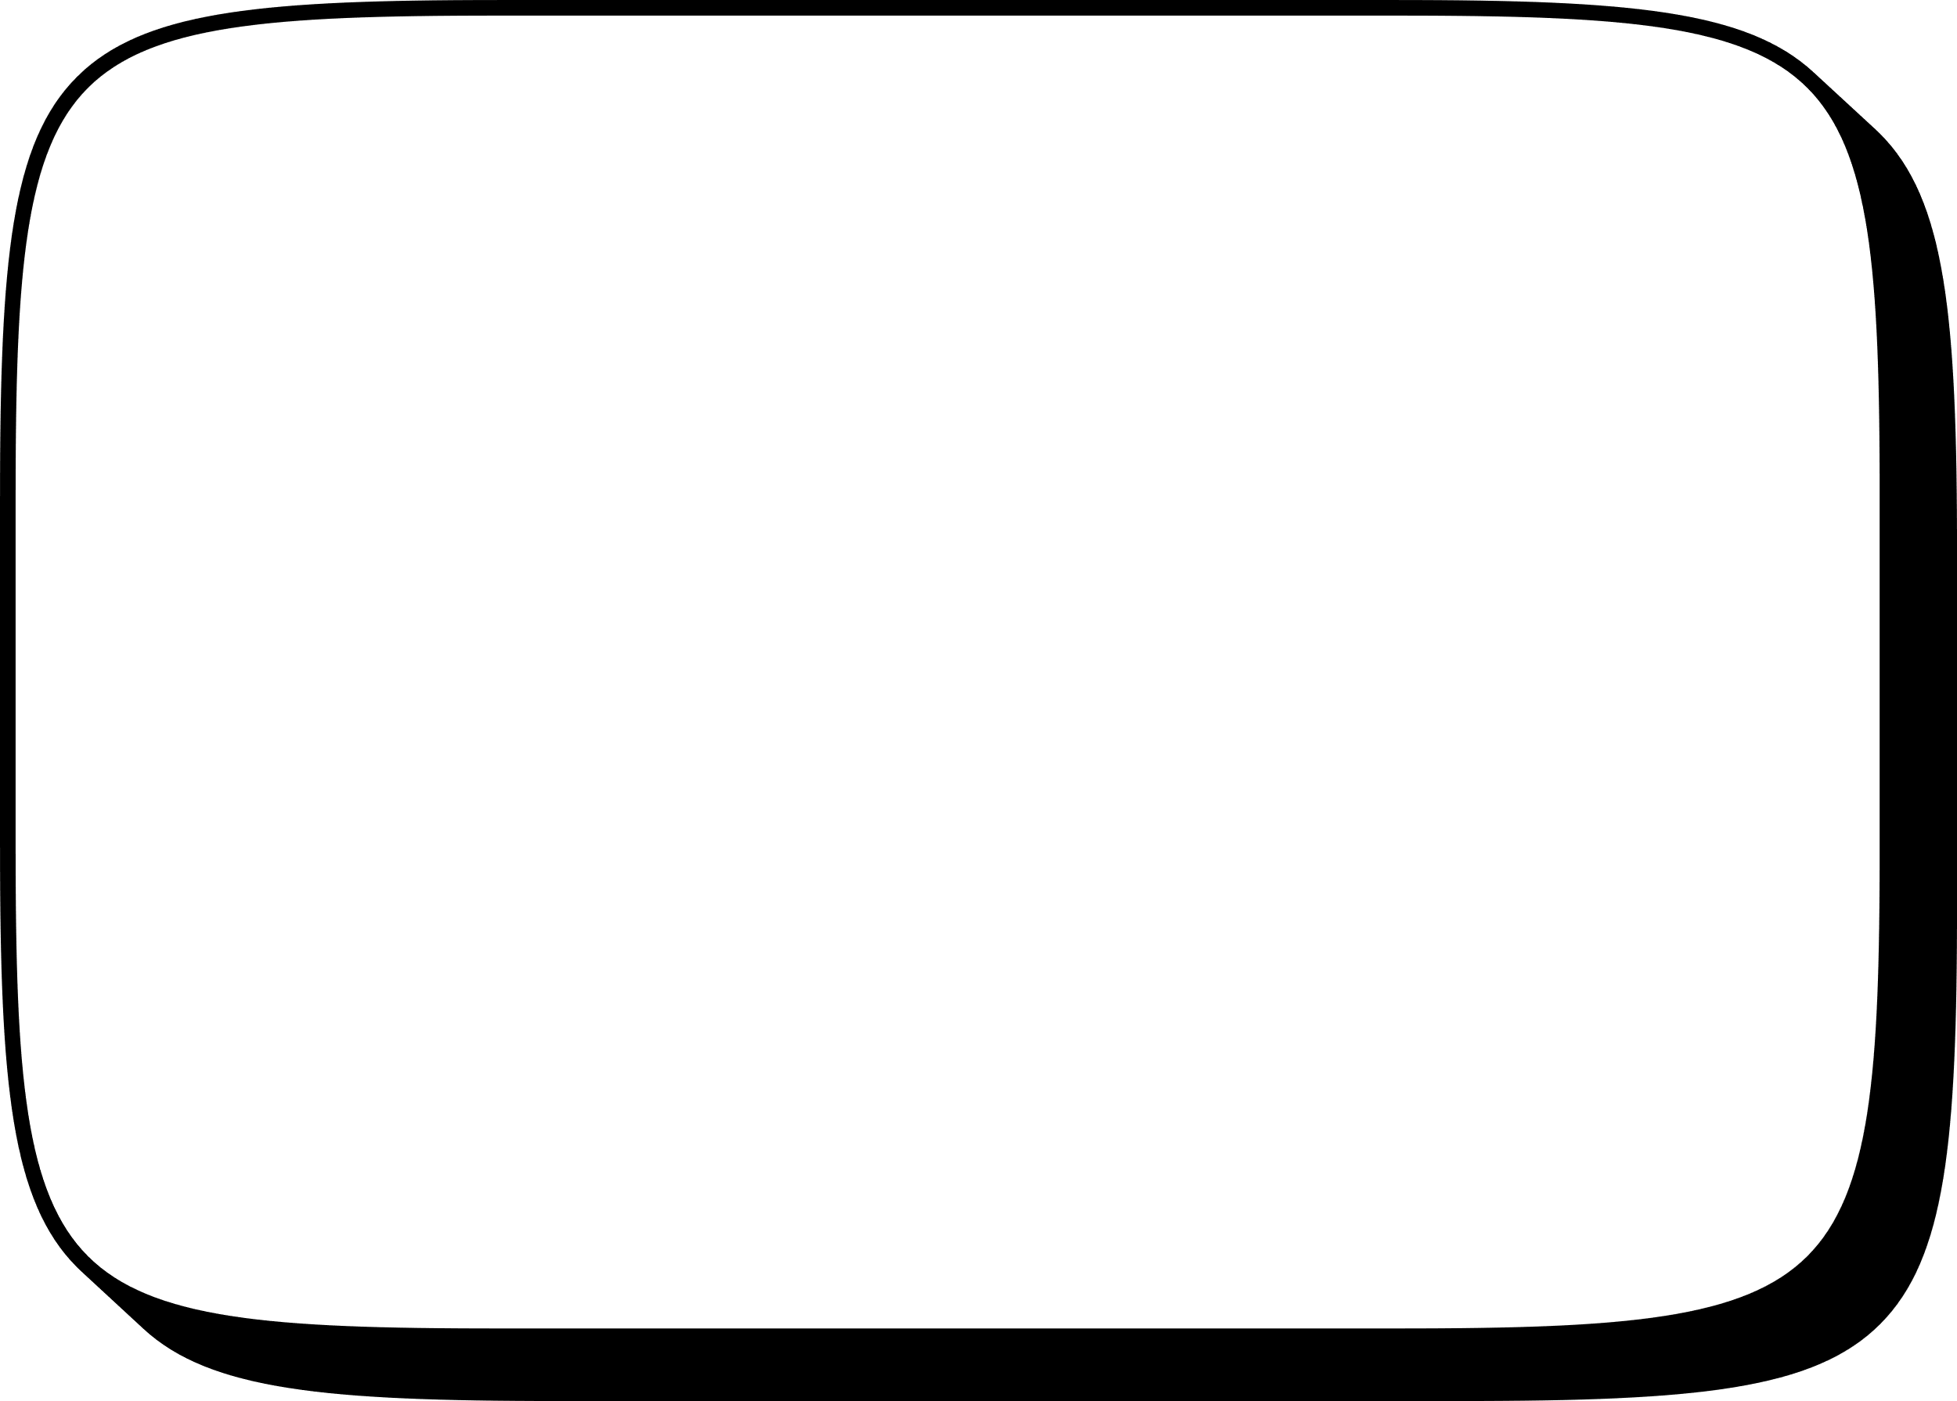
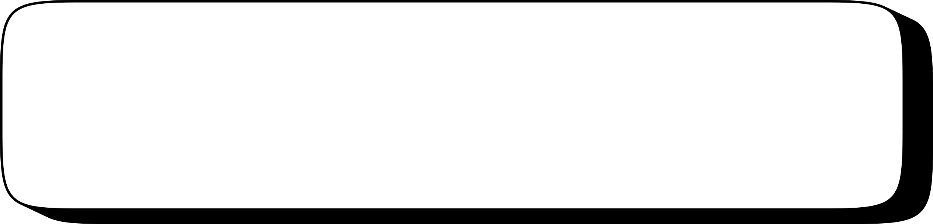
Methodology
Creating a subset of dataset to address computational limitations,
Ensure that the dataset captures important connections
Preprocessing of
Original Dataset
Feature engineering for
graph dataset
Selecting the GNN Model
Split dataset into train(80%) and test(20%)
Graph Construction
Training on the stratified sampled dataset
Prediction on test split
Notes:
So, this is the whole process of the project After preprocess the dataset such as normalize them remove empty rows, change categorical feature to numerical features, manage the dates of transaction. Since I don’t have much computational power so I decided to make a smaller dataset so I created a small dataset, then Go through the Graph construction while change the feature in such a way that it will help in making Graph, the I decided to use GAT model. I have split the dataset into 8:2 ratio. Since The dataset is too much imbalance, I have weight for calculation of loss in this way Fraud sample will have high weightage then Not Fraud sample, without using this weights all node was classified as Not Fraud. I have calculated weigthed precision and normal recall because correct Fraud sample will able to contribute to precision score and recall will help in monitoring the Fraud sample only

Slide 12
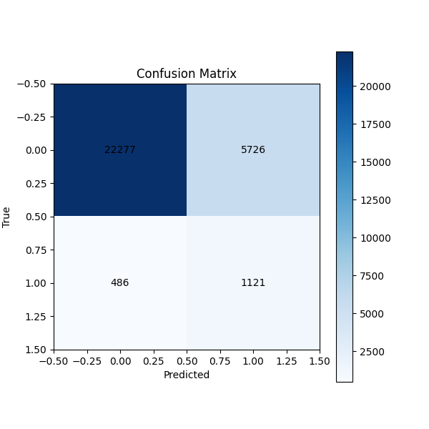
Evaluation Metrics and Results
01
True positive rate (recall)
True Positive Rate (TPR) / Recall: Indicates the model's ability to correctly identify fraudulent accounts out of all actual fraud cases.
Formula: TP/(TP+FN) = 0.697
02
Test Accuracy
Test Accuracy = (TP+TN)/(TP+TN+FP+FN) = 0.790
Notes:
Here is the confusion matrix of our best result from Edge Enhancement model.
So, our final TPR score is 0.697 means our model is able to predict 69.7% of the Fraud sample and the test accuracy is 79% since
It is move from 0.6 to 0.697 after adding and MLP layer for feature transformation and It also change the accuracy from 73% to 79%.

Slide 13
Conclusion
Fraud Detection with GATs
Utilized Graph Attention Networks (GATs) to model financial transactions as graphs, capturing complex relationships between accounts.
Creation of New Dataset
Generated a new, more manageable dataset due to computational limitations, enabling efficient model training.
Applied class weights to mitigate the impact of class imbalance, improving the model's sensitivity to fraudulent transactions.
Addressing Class Imbalance
Performance Improvement
Integrated a neural network to enhance edge transformations, boosting the True Positive Rate (TPR) from 60% to 69%.

Slide 14
Future Work
Enhanced GNN Architectures
Explore advanced Graph Neural Network models like GCNs, GraphSAGE, and GINs, as well as multi-level attention mechanisms, to improve the model’s ability to detect complex fraud patterns.
Subgraph-Level Analysis
Develop models to classify entire transaction trails or subgraphs as fraudulent or non-fraudulent, enabling detection of intricate money-laundering schemes spanning multiple transactions.
Develop a model to reconstruct and complete incomplete transaction trails, uncovering hidden fraud patterns and improving the dataset's comprehensiveness.
Generating and Completing Transaction Trails

Slide 15
Thank You

